Slide 1
DESIGN AND FABRICATION OF FIST CLUTCH
THANGA PRAKASH M 312319114146
VARUN D 312319114151
Mr.ASM.UDAYAKUMAR M.E.,(Ph.D)
Associate professor,
Department of Mechanical Engineering,
St.Joseph’s College of Engineering.

Slide 2
CONTENT
INTRODUCTION
ABSTRACT
OBJECTIVE
COMPONENTS
DESIGN CALCULATION
ADVANTAGES
APPLICATION
CONCLUSION

Slide 3
INTRODUCTION
We have pleasure in introducing our new project “FIST CLUTCH”, which is fully equipped by mechanical arrangement and electro-magnetic clutch engagement mechanism.
It is a genuine project which is fully equipped and designed for Automobile vehicles. This forms an integral part of best quality. This product underwent strenuous test in our Automobile vehicles and it is good.
Car safety is the avoidance of automobile accidents or the minimization of harmful effects of accidents, in particular as pertaining to human life and health.
Special safety features have been built into cars for years, some for the safety of car's occupants only, and some for the safety of others.

Slide 4
ABSTRACT
The technology of pneumatics has gained tremendous importance in the field of workplace rationalization and automation from old-fashioned timber works and coal mines to modern machine shops and space robots.
It is therefore important that technicians and engineers should have a good knowledge of pneumatic system, air operated valves and accessories.
The air is compressed in an air compressor and from the compressor plant the flow medium is transmitted to the pneumatic cylinder through a well laid pipe line system.
To maintain optimum efficiency of pneumatic system, it is of vital importance that pressure drop between generation and consumption of compressed air is kept very low.
In this project we also added the feature i.e. it can be used for disabled person by button operated clutch.

Slide 5
OBJECTIVE
The objective of this project is to fabricate a fist clutch which can be operated by just using a push button . This system is designed as user friendly to disabled person too. In this project we use the push button to operate the clutch. Push button is attached on the top of the gear lever.
When we press the button, it switches on the solenoid valve which operates the pneumatic cylinder and presses the clutch pedal. Clutch pedal is comprised of return spring that retracts the clutch pedal.
We use the compressor and several pneumatic components for the air supply. As the button is attached to the gear lever, it is easy for disabled person to operate the clutch by a single press.

Slide 6
COMPONENTS USED
S.No. | Components
1 | Solenoid Valve
2 | Push Button
3 | Pneumatic Cylinder
4 | Spring
5 | Pedal
6 | Tube
7 | Frame

Slide 7
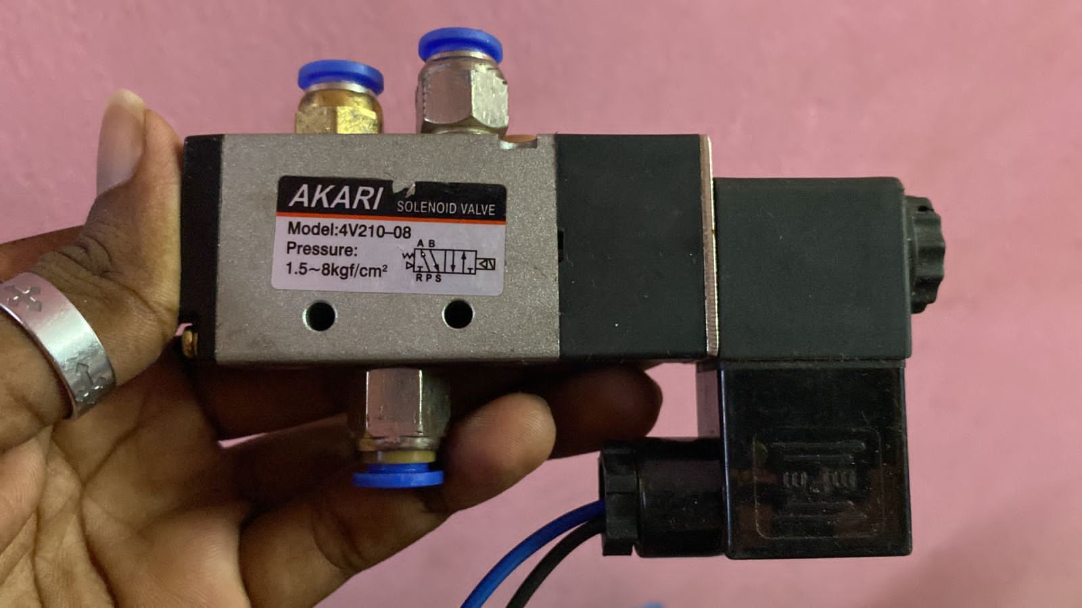
SOLENOID VALVE
Solenoid valves are used in fluid power pneumatic and hydraulic systems, to control cylinders, fluid power motors or larger industrial valves.
Solenoid valves are control units which, when electrically energized or de-energized, either shut off or allow fluid flow.
The actuator takes the form of an electromagnet. When energized, a magnetic field builds up which pulls a plunger or pivoted armature against the action of a spring.
When de-energized, the plunger or pivoted armature is returned to its original position by the spring action

Slide 8
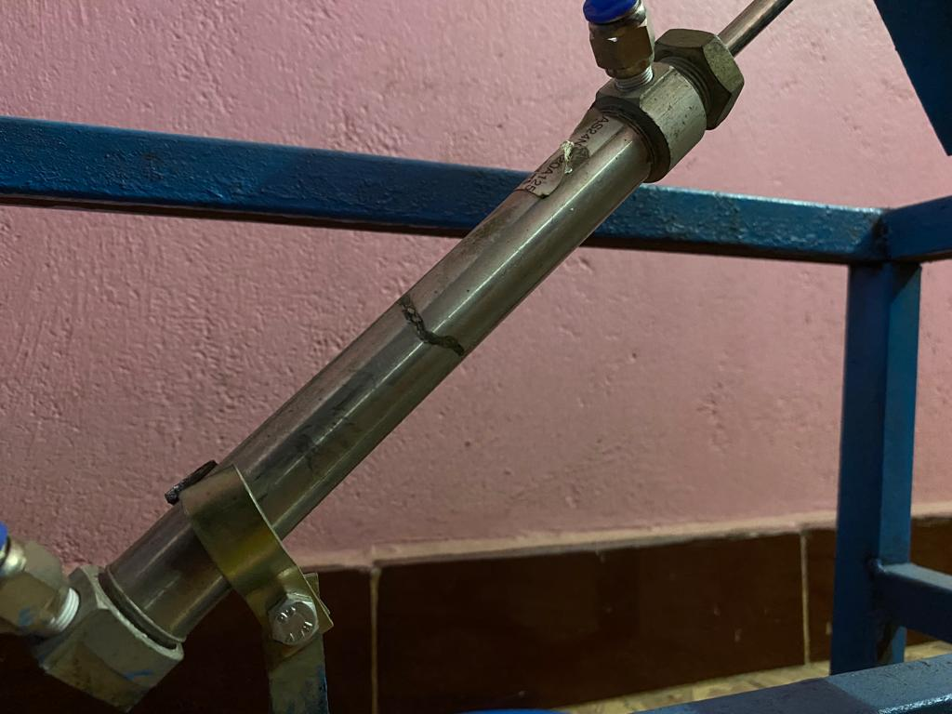
PNEUMATIC CYLINDER
Pneumatic cylinder is an assembly used in Automobiles in the clutch actuating mechanism.
It is primarily used to reduce manual effort needed to disengage the clutch whenever gear shift is required.
This includes actuating mechanism interposed in perpendicular direction to the output force is acted upon hydraulic and pneumatic pressures to achieve balancing position.
This enables the operation smooth and gradual output force delivery.

Slide 9
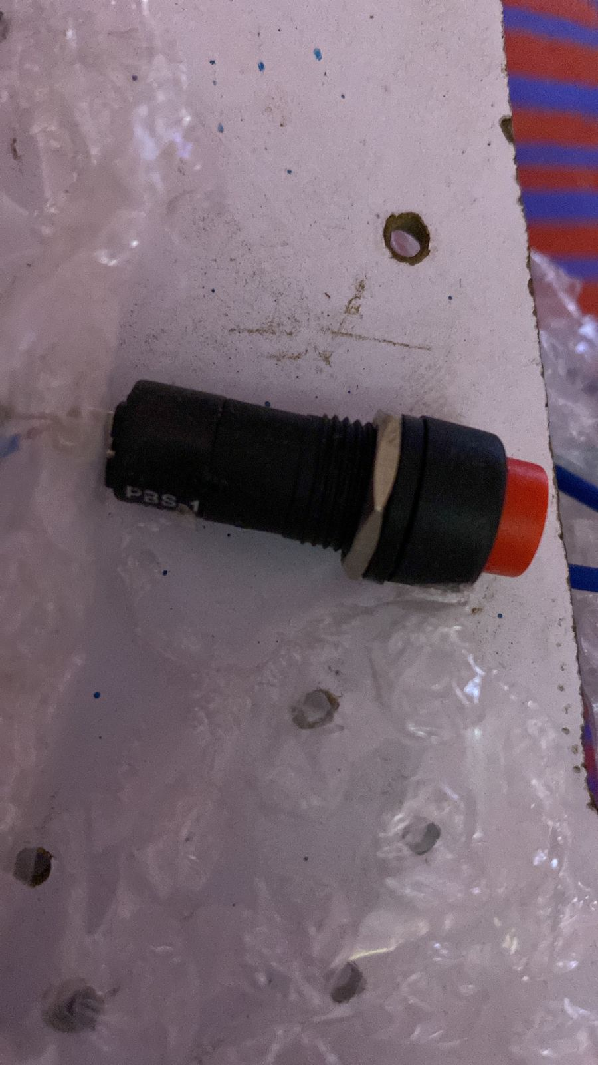
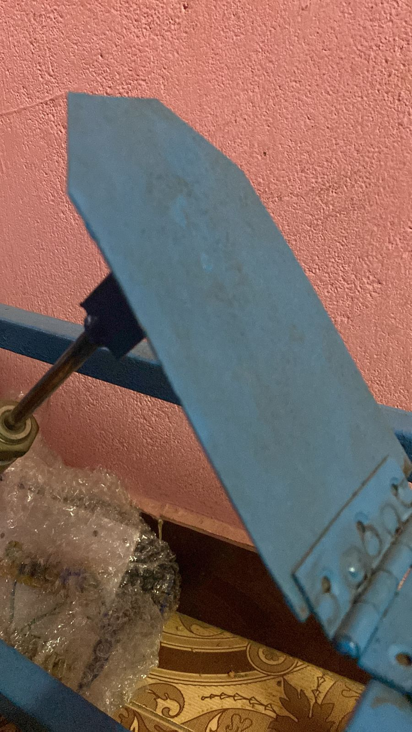
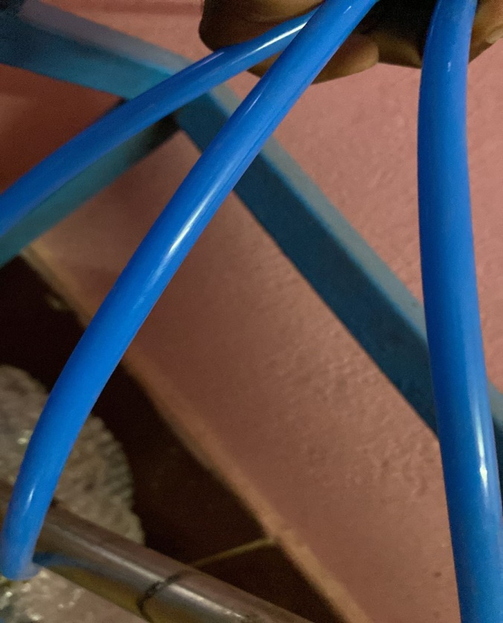
PUSH BUTTON
PEDAL
TUBES

Slide 10
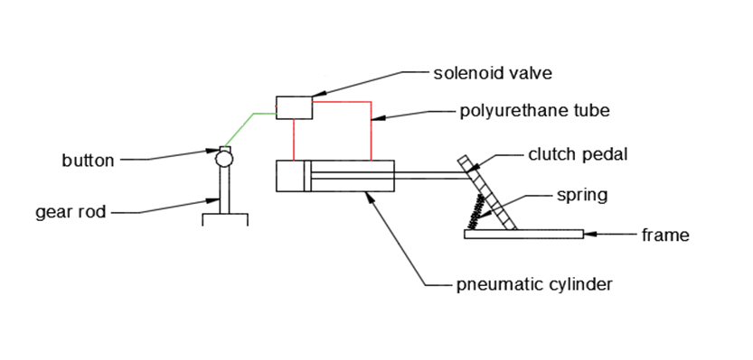
2D LAYOUT

Slide 11
DESIGN CALCULATION
PNEUMATIC CYLINDER DESIGN:
Design of Piston rod:
Load due to air Pressure.
Diameter of the Piston (d) = 20 mm
Pressure acting (p) = 6 kgf/cm²
= 6 ×0.981
= 5.886 bar = 0.5886N/mm²
Material used for rod =C 45
(Data book page no 1.12)
Yield stress (σ_{y}) =36 kgf/mm²
=36×98.1
=3531.6 bar
= 353.16N/mm²
Factor of safety =2(data book page.no 8.19)

Slide 12
Force acting on the rod (F) = Pressure x Area
= p x (Πd² / 4)
= 0.5886 x {(Π x 20² ) / 4 }
F = 739.6 N
Design Stress(σ_{y}) = σy / F0 S
= 353.16 / 2 = 176.5N/mm²
∴d = √4F/π [σy]
= √ (4×739.6)/ π[176.5]
∴ Minimum diameter of rod required for the load = 2.3 mm
We assume diameter of the rod = 7.5 mm
Length of piston rod:
Approach stroke = 160 mm
Length of threads = 2 x 20 = 40mm
Extra length due to front cover = 12 mm
Extra length of accommodate head = 20 mm
Total length of the piston rod = 160 + 20 + 12 + 20
= 212 mm
By standardizing, length of the piston rod = 210 mm.

Slide 13
ADVANTAGES
It requires simple maintenance cares
The safety system for automobile.
Checking and cleaning are easy, because of the main parts are screwed.
Easy to handle.
Repairing is easy.
Replacement of parts is easy.
Used by disabled persons.

Slide 14
APPLICATTIONS
It is very much useful for Car Owners & Auto-garages.
Thus it can be useful for the following types of vehicles;
MARUTI,
AMBASSADOR,
FIAT,
MAHINDRA,
TATA

Slide 15
CONCLUSION
No matter the application, the function and purpose of a clutch is to transmit torque from a rotating driving motor to a transmission. Clutches require a mode of actuation in order to break the transmission of torque.

Slide 16
THANK YOU

